Slide 1

Biomedical Monitoring for Astronauts
Team 310 4/4/2024

Slide 2
Table of Contents
Team Introduction
Project Assignment
Project Description
Motivation
Selected Design
Design Implementation
System Overview
Sensor Protocols
PCB Overview
Software Overview
Budget & Future Work
Lessons Learned

Slide 3
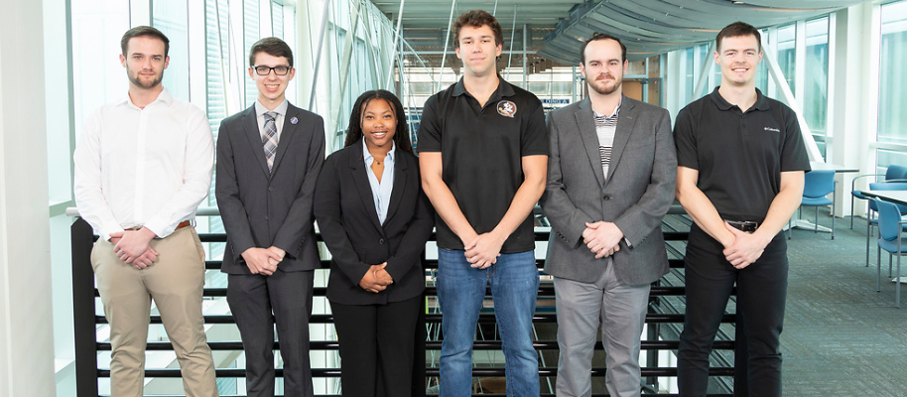
Team Introductions
Evan Cloutier
Project Manager
Austin Roberts
Sensors Engineer
Jada Davis
Software Engineer
Dallas Toth Test Engineer
Landon Hicks
PCB Design Engineer
Nick Billmire
Digital Comm. Engineer

Slide 4
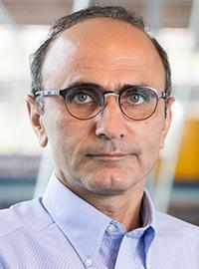
Sponsor and Advisors
Sponsor
L3Harris Technologies
Faculty Advisor
Babak Noroozi, Ph.D.
Professor

Slide 5
Project Assignment

Slide 6
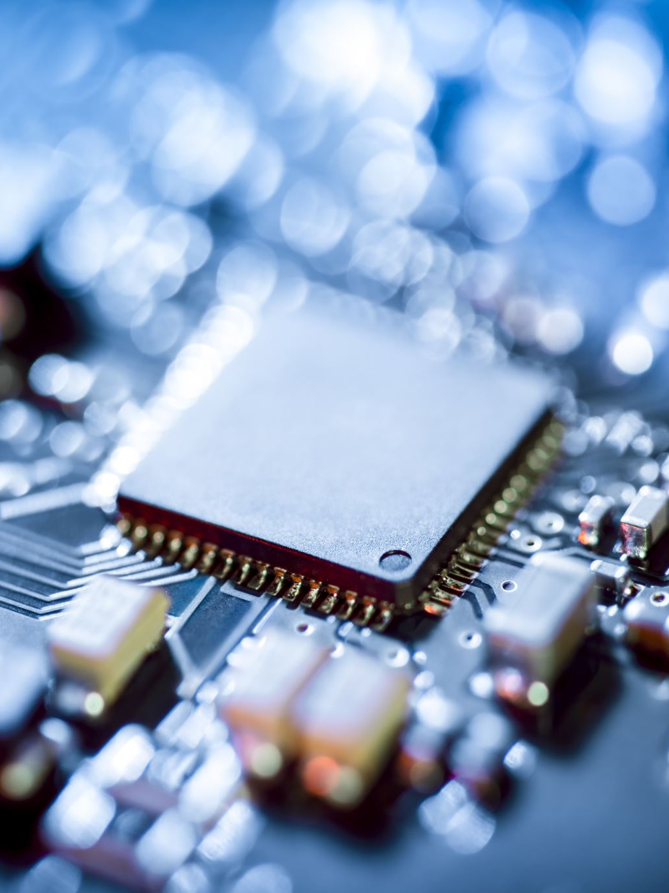
Original L3Harris Project Description
Multi-Axial Angular Sensor:​
A form/fit/function replacement​
Design a circuit card assembly for a provided sensor​
Develop code needed to output the proper message format ​
Construct the card within given size limitations​
Regulate power to the sensor​
Output in RS-422 message format

Slide 7
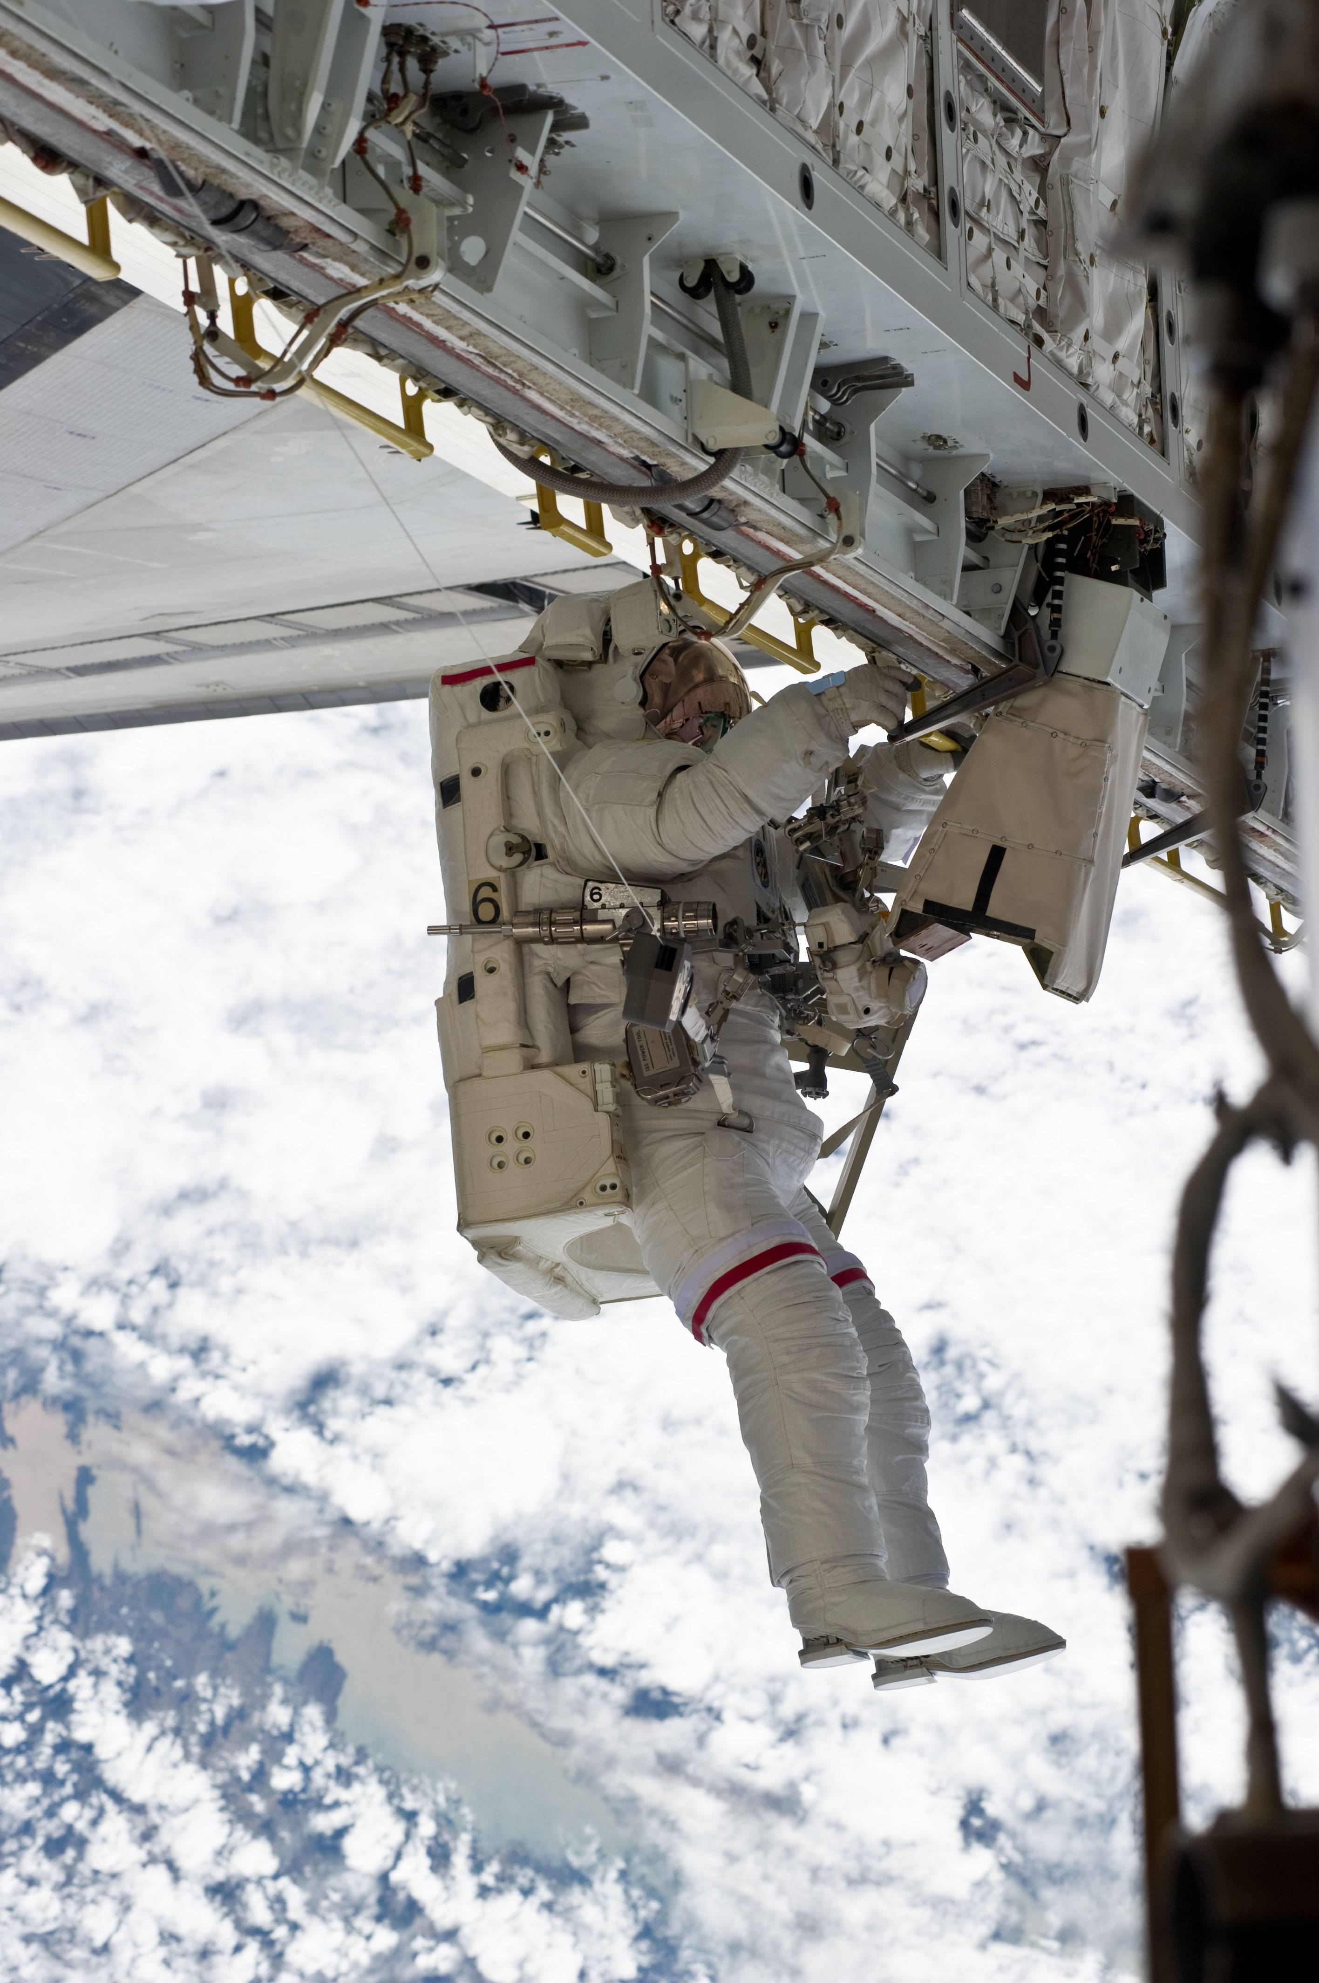
Current Project Description
Sensor package capable of monitoring an astronaut’s vital signs and spacesuit environment during extravehicular activity (EVA).
Transmit sensor data to the main communications system via a serial interface.
Detect abnormal readings and trigger appropriate alarms.

Slide 8
Motivation Behind Concept Generation & Selection
Attempts to adapt original project scope
Limited definition
Use of IMU's
Decision to explore new, unique project ideas
Research & Deliberation
Inspiration from prior research projects
Final Project Definition
Wearable Sensor Suites
Work-out sleeve containing IMU’s
Biomedical monitoring for astronauts (BMA)

Slide 9
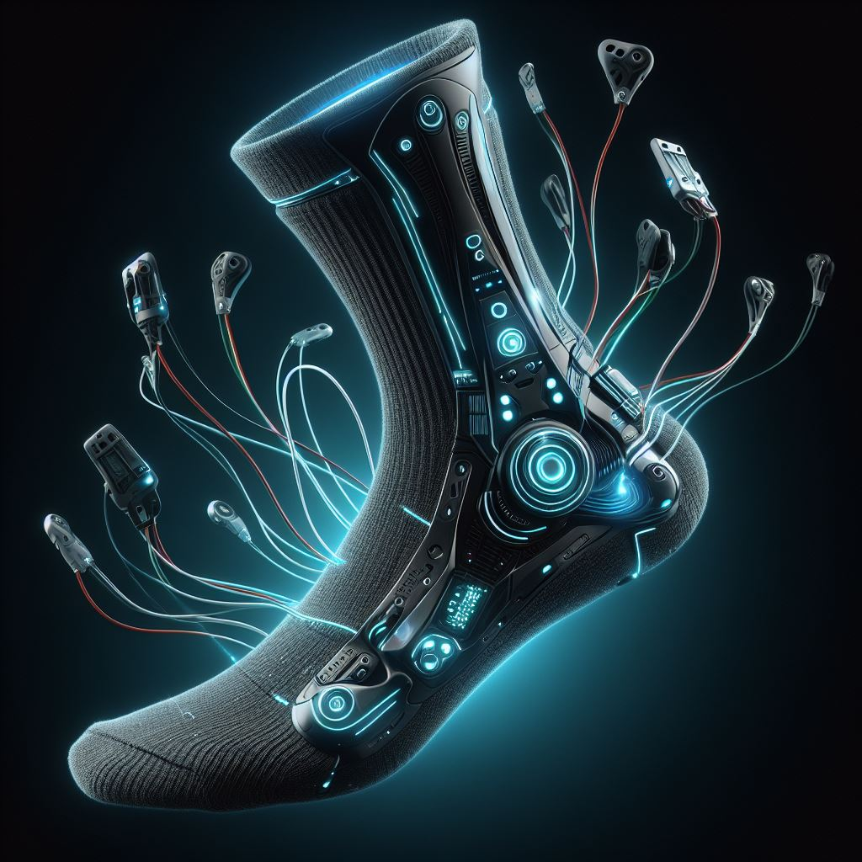
Selected Design
Sensing Sock and Environment Sensor Package
Wearable sock
Heart rate sensor
Pulse oximeter
Thermometer
Galvanic skin response sensor
Spacesuit environment sensors
CO2
Pressure
Temperature/Humidity
Goal: create a proof-of-concept design to be used for testing and research purposes.
Artistic rendering only; not an actual depiction.

Slide 10
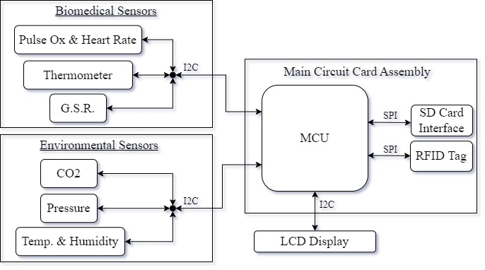
Design Block Diagram

Slide 11
Design Implementation

Slide 12
Sensor System - Overview
BMP280 – Pressure (Pa)
Telaire T6793 – CO2 Concentration (ppm)
MAX30205 – Body Temperature
ECG_GSR Click – GSR Sensor PCB
SHT85 – Ambient Temperature and Humidity
MAX-REFDES117 – Heart Rate and Pulse Oximetry

Slide 13
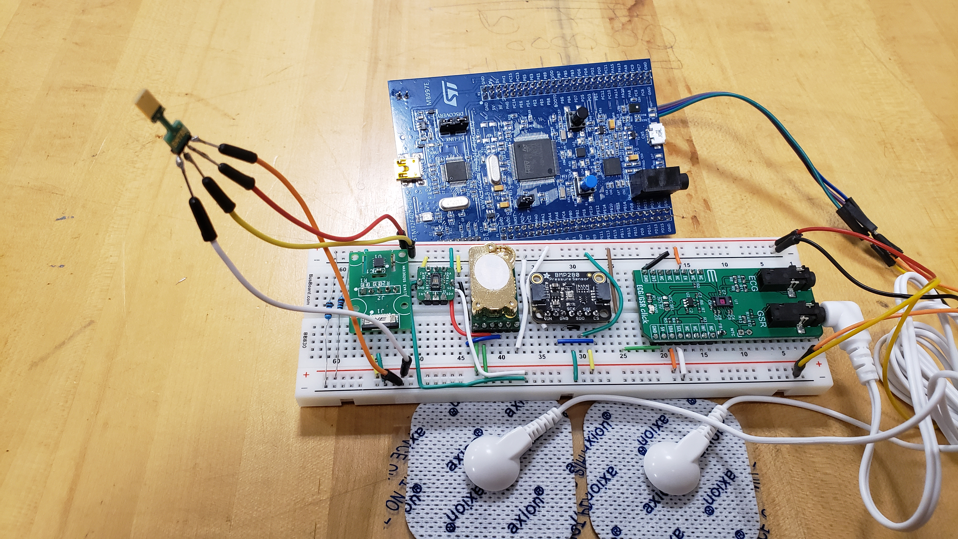
Sensor System
Notes:
Photo of the breadboard with sensors on it here. Explain the connections without going into detail about software or each sensor’s specs

Slide 14
Sensor Protocols
Amongst other communication protocols, I²C and SPI interfaces protocols are used in the design.
I²C was used for the sensor suite.
SPI for the RFID and SD card applications.
Due to the nature of both protocols, it was within best judgement that these two protocols were the most applicable for this design.

Slide 15
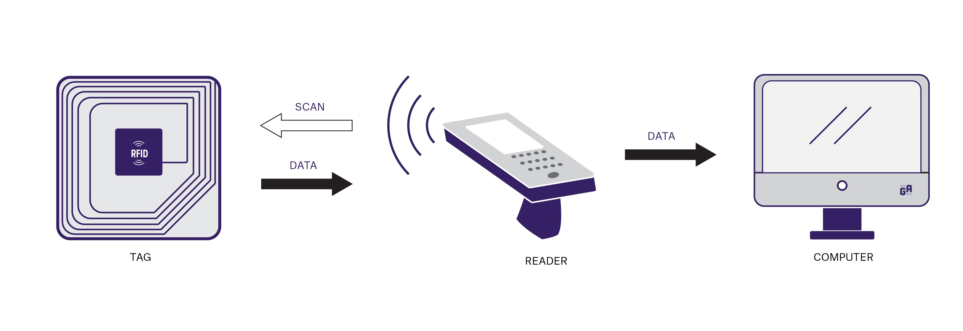
Radio Frequency ID
Suggested per our advisor to attempt to apply RFID as a means of wireless communication.
Assess whether RFID could be used to transmit data in real time.

Slide 16
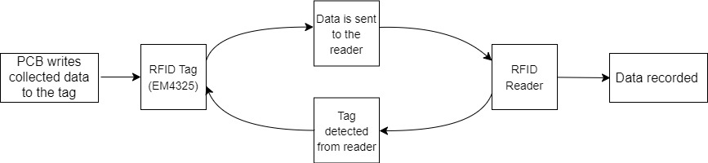
RFID System Overview
Constantly reading and rewriting (no need for WORM)
RF carrier frequency (860 – 960) MHz
Max RF power: 25dBm / 315mW

Slide 17
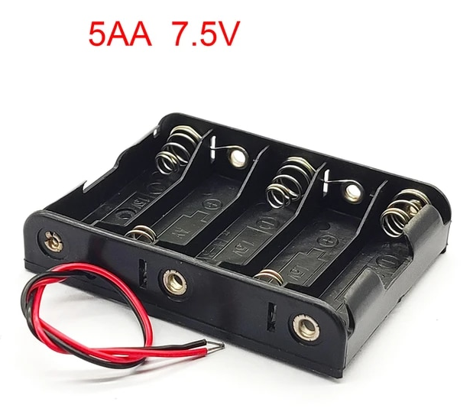
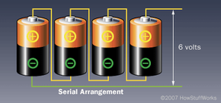
System Power
40mA theoretical current draw
7.5V battery pack constructed from AA batteries
50-62.5hr life

Slide 18
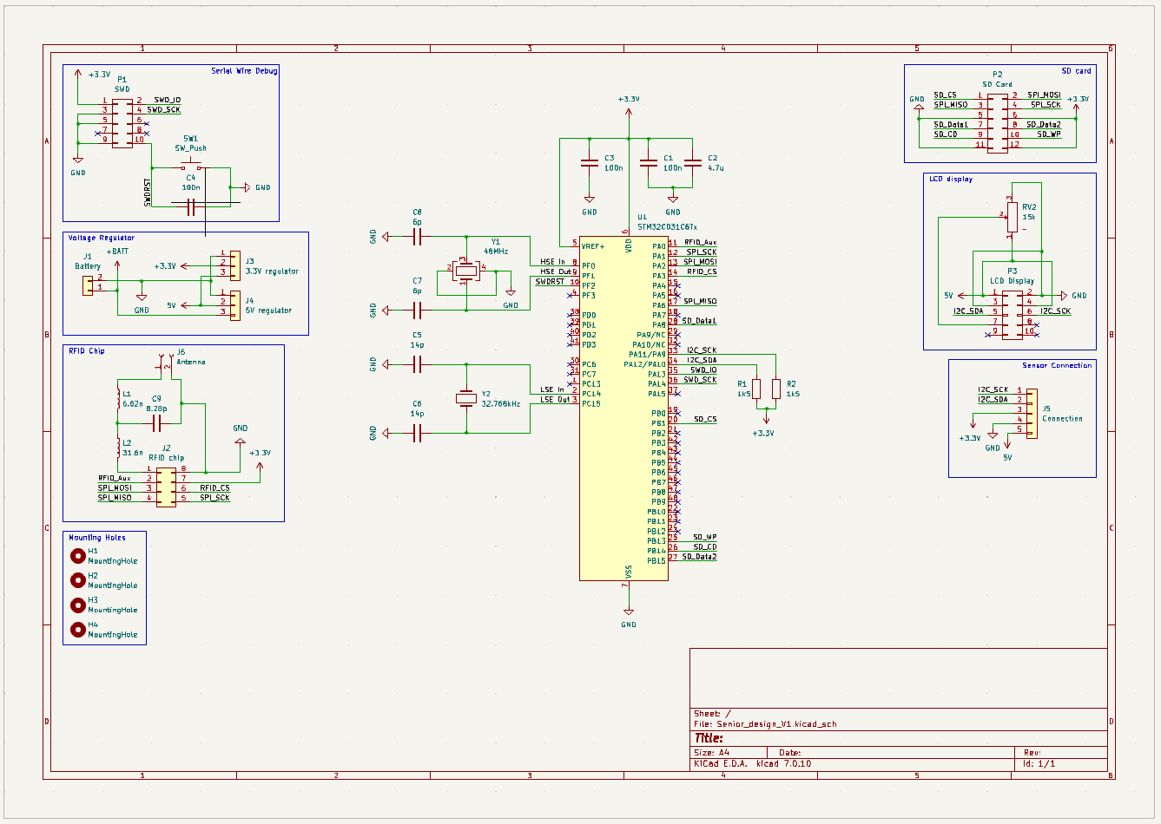
Printed Circuit Board – Overview
2-layer board
Ground plane
Power/signal plane
FR-4 substrate
50 x 51.6mm
37 Through vias

Slide 19
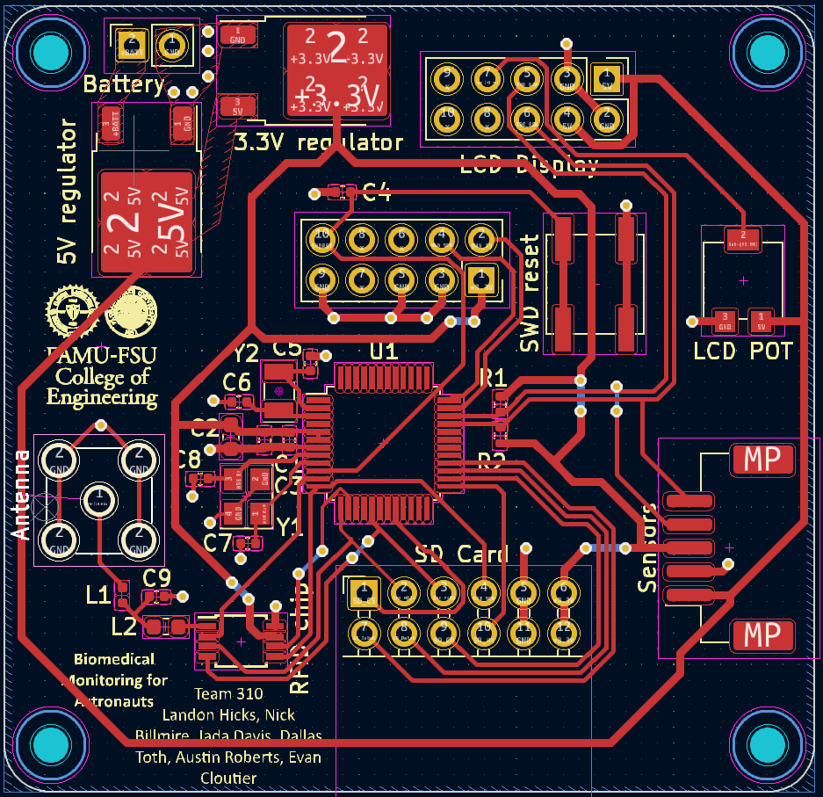
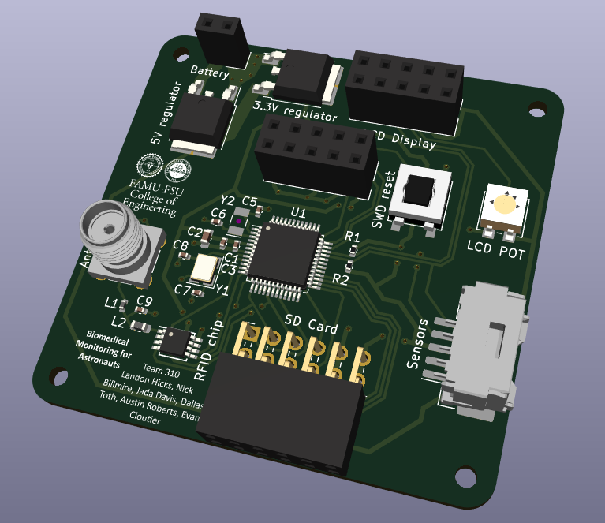
PCB Design
Notes:
Include where we will order the PCB from, or if it will be made by Hooker
Mention how many layers the PCB will have, also pricing if available, and justify these.
Consider how to assemble the PCB, especially how to connect middle layers to the pin (not needed for the presentation, but important to think about).

Slide 20
Software – Overview
Main functions:
Read Sensor Data
Display Sensor Data
Analyze Sensor Data
Store Sensor Data
Hardware Utilized:
STM32F4 Discovery Board MCU
LCD I²C Character Display
Buzzer

Slide 21
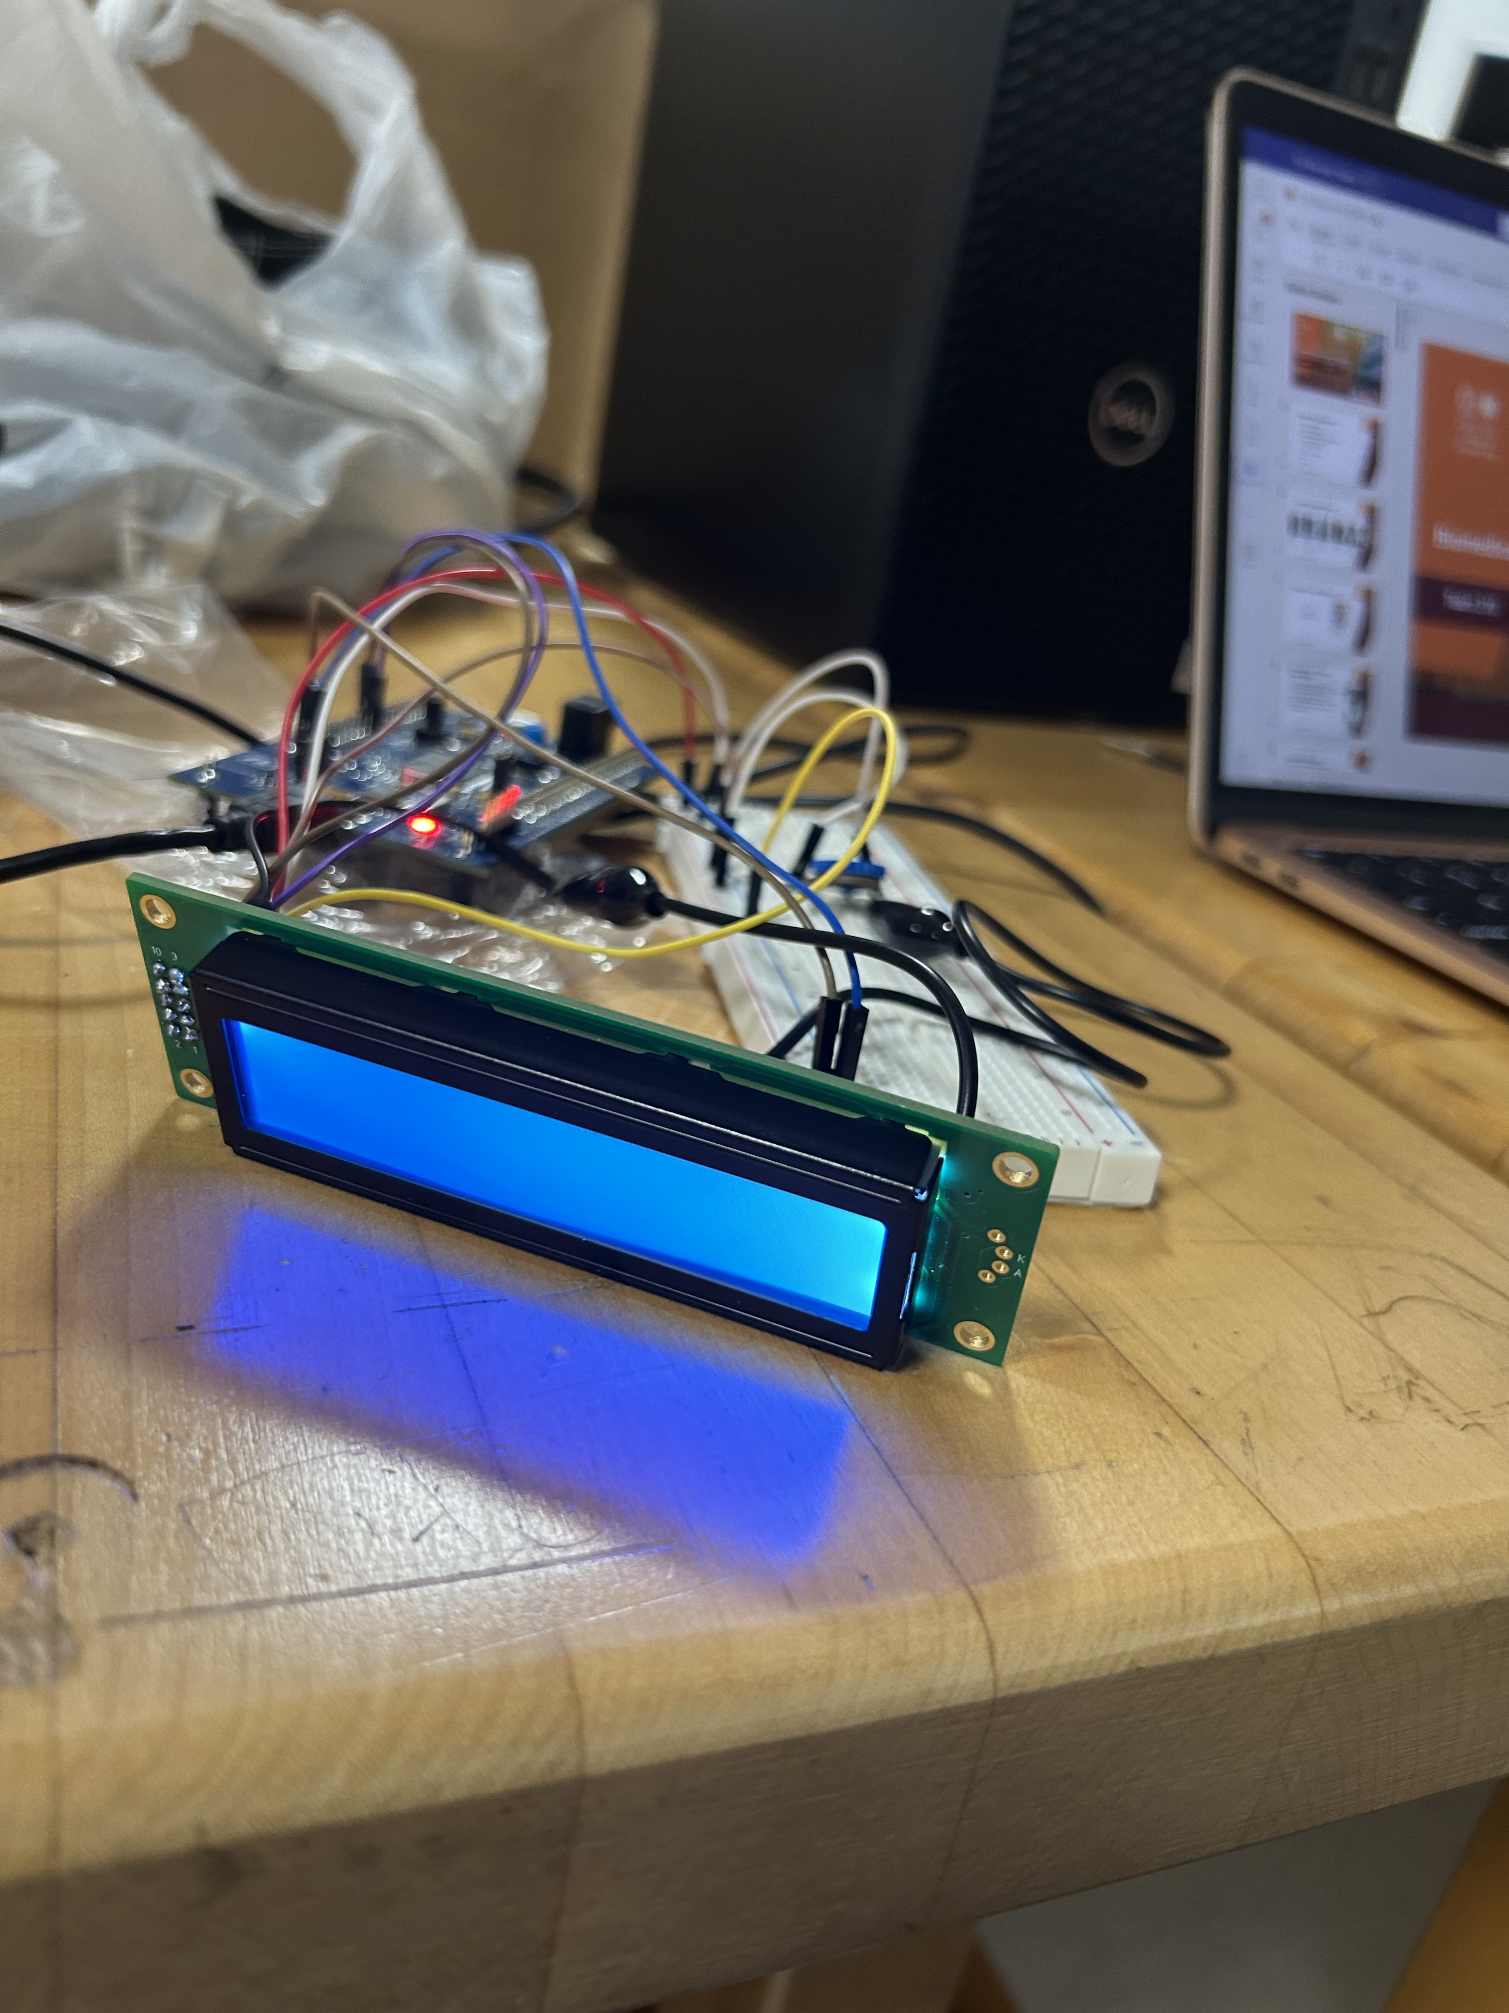
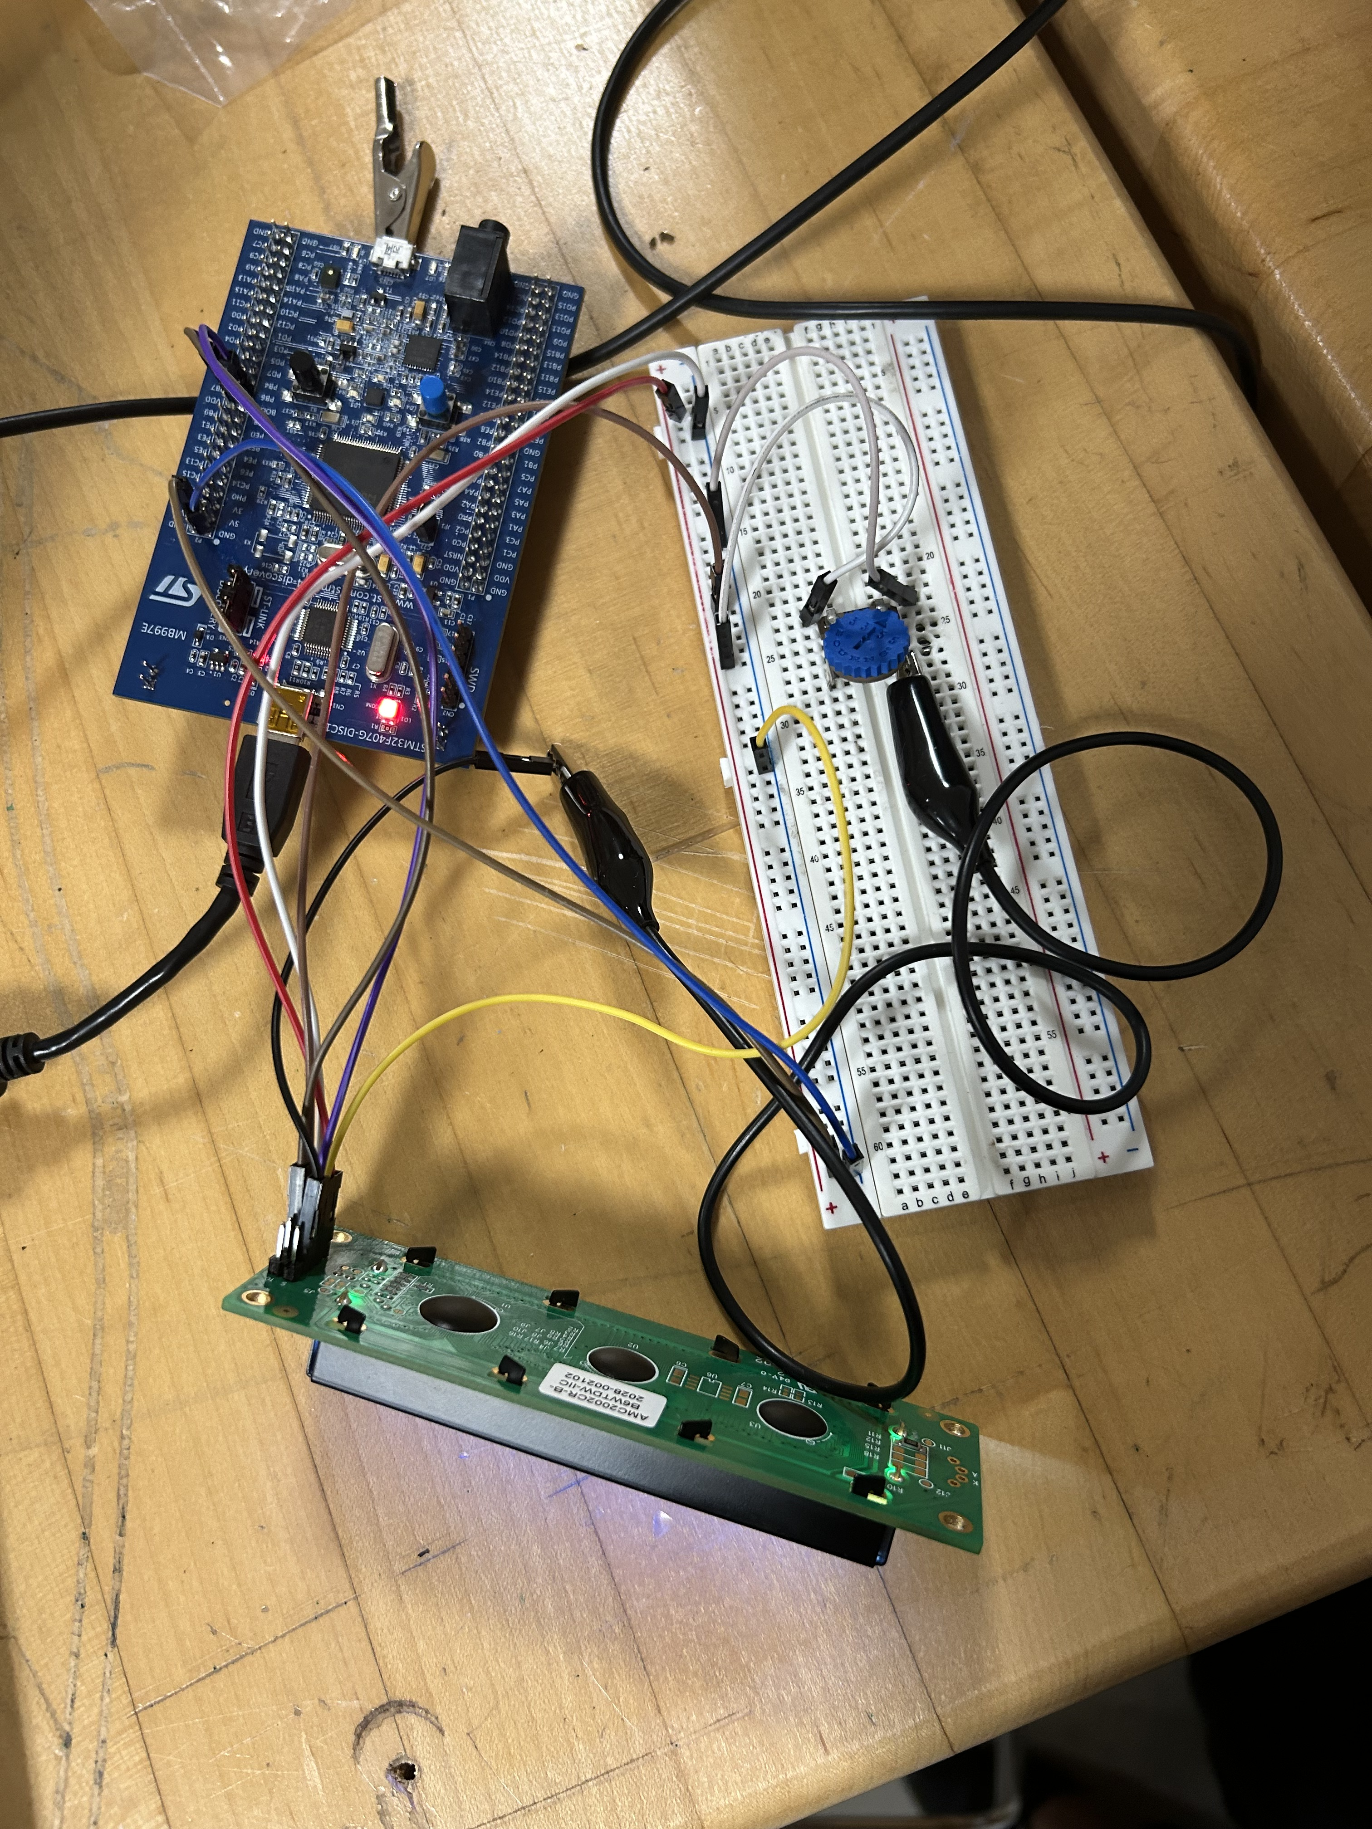
Software Architecture
Display sensor data –> LCD
Each sensor reading displayed on a timer on a continuous slide.
Update in real time.
Sensor | Pulse Ox | Heart Rate | GSR | CO2 | Pressure | Temp | Humidity
Unit | SpO2% | Beat/min | Ohms | ppm | atm | Celcius | Relative%

Slide 22
Software Architecture cont.
Analyze sensor data
Watch for concerning values
Thresholding readings
Display warnings –> LCD
Trigger alarms -> Buzzer
Pulse Width Modulation
Alarm will sound in 3 second intervals
WARNING
CHECK VITALS

Slide 23
Software Architecture cont.
Store sensor data
CSV files --> SD Card
All current sensor data will be written to the file every 10 seconds
Time | Sensor | Reading

Slide 24
Budget & Future Work

Slide 25
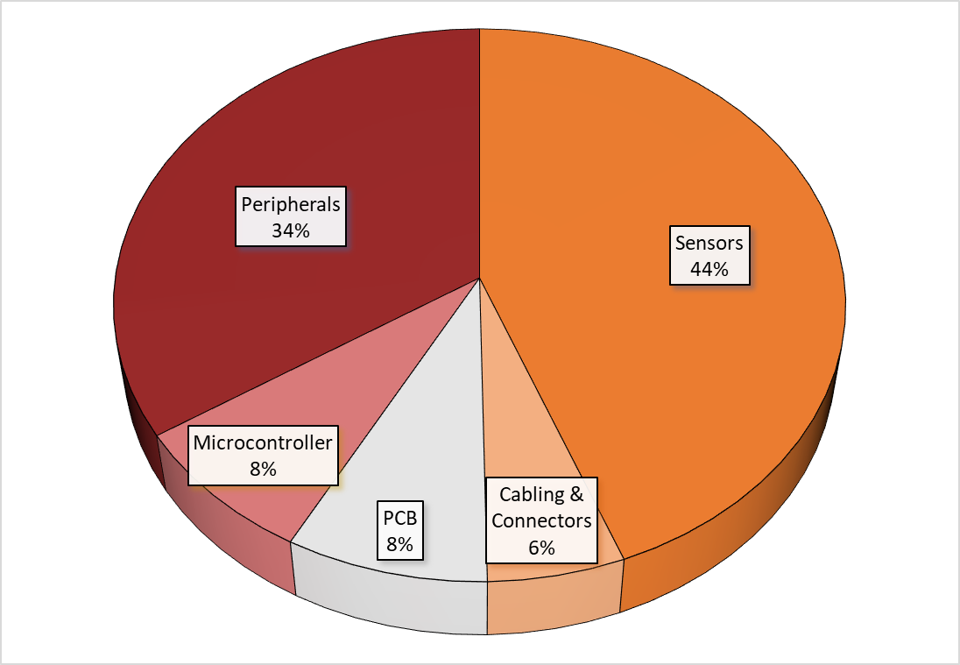
Budget Breakdown

Slide 26
Future Work
Formal tests done with PCB
Sensor readings
Alarm thresholds
Construct final wearable
Sensors onto sock
Housing unit for PCB
Address limitations of pulse ox and heart rate sensor
Reliability

Slide 27
Future Work
PCB Housing
Reliability & Redundancy
Systems in place for failures
Power failure backup power
Software in place for malfunctions and inaccurate readings to detect when sensor broken
Managing battery life

Slide 28
Lessons Learned
Clearly defined and well documented project outline is important.
Organization ensures efficiency
PCB Design Process
Sensor Integration

Slide 29
Questions?

Slide 30
Additional Slides & Resources

Slide 31
Backup Slides Index
Citations
Full B.O.M.
Details for sensors and their algorithm(s)
MCU Details
RFID Details
I2C vs. SPI Benefits & Drawbacks

Slide 32
Citations
Fei, D.-Y., Zhao, X., Boanca, C., Hughes, E., Bai, O., Merrell, R., & Rafiq, A. (2010). A biomedical sensor system for real-time monitoring of astronauts’ physiological parameters during extra-vehicular activities. Computers in Biology and Medicine, 40(7), 635–642. https://doi.org/10.1016/j.compbiomed.2010.05.001

Slide 33
Bill of Materials
 | SD Team 310 - Bill of Materials
 | Item Ref # | Description | Part Num. | Quantity | Unit | Unit Cost | Cost | Total Cost
Bio. Sensing | 1 | Sock | N/A | 1 | 6 pack | $15.00 | $15.00 | $15.00
 | 2 | Heart Rate / Blood O2 Sensor | MAXREFDES117 | 2 | individual | $19.02 | $38.04 | $38.04
 | 3 | Body Temperature | MAX30205EVSYS# | 2 | individual | $59.55 | $119.10 | $119.10
 | 4 | Skin Galvanic Sensor | MIKROE-4500 | 2 | individual | $27.00 | $54.00 | $54.00
 | 5 |  |  |  |  |  |  | $0.00
Env. Sensing | 8 | CO2 Sensor | T6793-5K | 2 | individual | $38.90 | $77.80 | $77.80
 | 9 | Pressure Sensor | BMP280 | 2 | individual | $9.95 | $19.90 | $19.90
 | 10 | Humidity Sensor | SHT85 | 2 | individual | $32.18 | $64.36 | $64.36
 | 11 |  |  |  |  |  |  | $0.00
 | 12 |  |  |  |  |  |  | $0.00
Processing | 13 | Microcontroller | STM32F407G-DISC1 | 2 | individual | $21.39 | $42.78 | $42.78
 | 14 | SD Card Storage | SDSDAF3-008G-I | 2 | individual | $11.37 | $22.74 | $22.74
 | 15 | SD Card Holder | 410-123 | 2 | individual | $11.86 | $23.72 | $23.72
 | 20 |  |  |  |  |  |  | $0.00
 | 22 | Character Display | AMC2002CR-B-B6WTDW-I2C | 2 | individual | $16.68 | $33.36 | $33.36
 | 23 | MCU (new & simplified) | NUCLEO-C031C6 | 2 | individual | $10.75 | $21.50 | $21.50
 | 24 | RFID Reader | Yanzeo SR3308 | 1 | individual | $189.00 | $189.00 | $189.00
 | 25 | Mini Micro Jst 2.0 Ph 4 Pin Connectors |  | 1 | pack of 20 | $7.56 | $7.56 | $7.56
 | 26
 | 28 | MPU | MSPM0G3507SPMR | 2 | individual | $2.50 | $5.00 | $5.00
 | 29 | Electrodes for skin |  | 1 | pack of 4 | $8.99 | $8.99 | $8.99
 | 31 |  |  |  |  |  |  | $0.00
 | 32 | RFID CHIP | EM4325V21TP8B+ | 3 | individual | $1.63 | $4.89 | $4.89
 |  |  |  |  | Assuming total shipping cost of 15% |  | $112.16 | $859.90

Slide 34
Sensor Details
Sensor Reading | Sampling Time | Precision | Reading Range | Reading Format | Typical Reading
GSR | 30 ms | 6-bit | 0-63 | 6-bit digital | ~32
HR & Pulse Ox | 4 seconds | 1 bpm/1% |  | BPM, % | 50-100, >95%
Pressure | ~7 ms | 1 Pa | Up to 110 kPa | Pa | 20-100 kPa
CO2 | 5 seconds | 45 ppm +3% | 0-5000ppm | ppm | < 2000 ppm
Body Temp | 5 ms | 16-bit S (2^-8) | Up to 80C | C | 92-99 F
Temperature | 5 ms | 1 deg F | -40 to 105C | C or F | 60-70 F
Humidity | 5 ms | 1% | 0-100% | % | 20-60%

Slide 35
Heart Rate & SpO2 Algorithm
Collect sensor data for 4 seconds, sample rate 25 Hz.
Zero-mean: the readings are typically on the order of around 100,000 otherwise. We also re-index the samples to be from –49.5 to +49.5, instead of 0 to 100.
Calculate the signal’s baseline (linear regression). Then subtract this baseline from the signal.
For heart rate: This is done by finding the first local maximum of the IR chan autocorrelation.
For SpO2: compare the relative intensities of R to IR using the RMS level of the zero-mean baselined signal compared to the mean of the raw signal. This quantity is called the Z ratio.
Plug the Z ratio into a corrective formula: SpO2 = (-45.06*Z + 30.354)*Z + 94.845.
Check that the correlation coefficient between R and IR channels greater than certain threshold (say 0.8). If it’s not, then discard the datapoint as erroneous.

Slide 36
OSHA CO2 Exposure
CO2 Concentration | Exposure Symptoms
5,000 ppm (0.5%) | OSHA limit (8 hours)
10,000 ppm (1.0%) | Possible drowsiness
15,000 ppm (1.5%) | Mild respiratory stimulation
40,000 ppm (4.0%) | Immediately dangerous to life and health

Slide 37
MCU Details
STM32F407G
Clock rate: up to 168 MHz
ARM Cortex M4, NVIC, MPU, FPU
1 MB flash, 112 KB + 16 KB SRAM
Peripherals: ethernet interface, CRC, USB interfaces, DMA, ADC, DAC, SPI, I2S, I2C, CAN, USART, 9 GPIO ports (16 pins each on most), Watchdog timer, 14 timers
STM32C031C6
Clock rate: up to 48 MHz
ARM Cortex M0
32KB flash, 12KB SRAM
-40C to 85C operating temp
Peripherals: USARTS, SPI, I2C (1 Mbps), DMA, ADC, 45 GPIO, 8 timers

Slide 38
Typical Spacesuit Conditions
Pressure: ~32.4 kPa (Armstrong's limit is 6.25 kPa)
Air composition: usually pure oxygen, with some water vapor
The sensors already in a space suit can vary, but are not contained in a single small garment.

Slide 39
RFID Info ref.
4096 bits non-volatile memory (EEPROM)
Forward (Transmission) rates 26.7 -128 kbps
Return rate – 40 to 640 kbps
Erase and write commands
Per manufacturer - applications include sensor monitoring, front end embedded syst, Gen2 communications for wireless data exchange, etc.
Reader range: 25m max

Slide 40
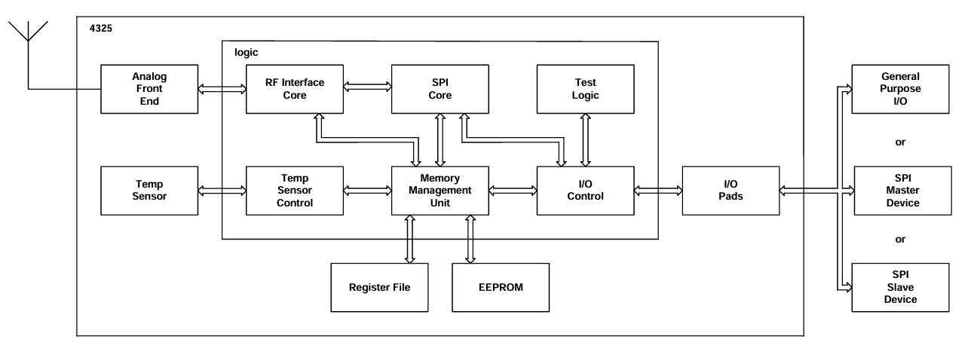
RFID IC Flowchart

Slide 41
Protocol Benefits
SPI
I²C
Speed
Can send data in real time
Full duplex
Ideal for interfacing to memory
Devices are independently addressable
Low power consumption
Fewer connections
Longer distance compared to SPI

Slide 42
Potential Drawbacks
SPI
I²C
Requires individual CS (chip select) lines in multiple peripherals
More wire connections
Short distance
Susceptible to noise
Half-Duplex
Increased processing overhead (more space)
Address conflicts
Susceptible to noise

Slide 43
Slide Headline
Try to keep text at 16 pt minimum.

Slide 44
Slide Headline
Try to keep text at 16 pt minimum.
Try to put as few words as possible on the slide if you’re using for a presentation.

Slide 45
Slide Headline
Try to keep text at 16 pt minimum.
Try to put as few words as possible on the slide if you’re using for a presentation.
Mix and match the backgrounds as shown in this template or just use one throughout.

Slide 46





Slide Headline
Try to keep text at 16 pt minimum.
Try to put as few words as possible on the slide if you’re using for a presentation.
Mix and match the backgrounds as shown in this template or just use one throughout.
You can put department/unit logos in slide master at Horizontal 0.89” Vertical 6.44” From top left corner

Slide 47
This is 10-point
This is 15–point Times
This is 20–point
This is 25–point
This is 30–point
This is 35–point
This is 40–point
This is 50–point
This is 60–point
This is 72–point
Notes:
Use at least 20-point font in Room A105, B134, and B136
Use at least 25-point font in Room B135

Slide 48
College of Engineering Color Palette
1 2 3 4
Pantone: PMS 195 C
RGB: 120, 47, 64
Hex: #782F40
CMYK:19, 90, 50, 55
1 2 3 4
Pantone: Black C
RGB: 0, 0, 0
Hex: #000000
CMYK:0, 0, 0, 100
Garnet
Black
1 2 3 4
RGB: 238, 118, 36
Hex: #EE7624
CMYK:2, 66, 99, 0
1 2 3 4
Pantone: PMS 000C
RGB: 255, 255, 255
Hex: #FFFFFF
CMYK: 0, 0, 0, 0
Fang
Orange
White
Notes:
Avoid 75% Black in B135

Slide 49
Accent Color Palette
1 2 3 4
RGB: 0, 59, 111
Hex: #003B6F
CMYK:
1 2 3 4
RGB: 0, 59, 111
Hex: #003B6F
CMYK:
1 2 3 4
RGB: 251, 236, 93
Hex: #FBEC5D
CMYK:
1 2 3 4
RGB: 219, 215, 210
Hex: #DBD7D2
CMYK:
1 2 3 4
RGB: 251, 236, 93
Hex: #FBEC5D
CMYK:
1 2 3 4
RGB: 219, 215, 210
Hex: #DBD7D2
CMYK:
Tardis Blue
Tardis Blue
Corn
Timberwolf
Corn
Timberwolf
1 2 3 4
RGB: 206, 0, 88
Hex: #CE0058
CMYK: 0, 100, 43, 12
1 2 3 4
RGB: 206, 0, 88
Hex: #CE0058
CMYK: 0, 100, 43, 12
1 2 3 4
RGB: 104, 40, 96
Hex: #682860
CMYK:
1 2 3 4
RGB: 220, 220, 220
Hex: #DCDCDC
CMYK:
Rubine Red
Rubine Red
Imperial
Gainsboro
1 2 3 4
RGB: 72, 146, 155
Hex: #48929b
CMYK:
1 2 3 4
RGB: 64, 224, 208
Hex: #40E0D0
CMYK:
1 2 3 4
RGB: 255, 139, 0
Hex: #FF8B00
CMYK:
Asagi-iro
Turquoise
American Orange
Notes:
Remove American orange add hyperlink grey
Make corn the last for b135
All work in 134 imperial move later
Tardis doesn’t work in b136

Slide 50
F7AB19
D67F15
EE7624
D64615
F73119
Analogous
https://color.adobe.com/create/color-wheel
6E3610
F0A16C
EE7624
6E4931
BASB1C
Monochromatic
A14508
4BED3B
EE7624
250CED
2010A1
Triad
A1470C
FF8C40
EE7624
0098A1
24E2ED
Complementary
28A164
2FED8D
EE7624
0848A1
1871ED
Split Complementary
EDAC2F
3BED93
EE7624
0C6AED
ED2F18
Double Split Complementary
ED660C
C7ED3B
EE7624
0CE1ED
A418ED
Square
BA7E09
87724A
EE7624
60EFCF
09BA61
Compound
AD551A
6E3610
EE7624
FA7625
D46820
Shades
Notes:
These are the variants that work well with Fang Orange. The bolded items show well on the projectors.

Slide 51
85412D
8F3831
782f40
8F3176
792D85
Analogous
https://color.adobe.com/create/color-wheel
C44D69
8E626D
782F40
C48796
451B25
Monochromatic
C43959
78743B
782F40
236178
43A2C4
Triad
C43959
C46078
782F40
25C43D
2F783A
Complementary
93C460
577835
782F40
39C49D
297861
Split Complementary
784435
5A783B
782F40
237860
6E2978
Double Split Complementary
782337
78683b
782F40
237830
293978
Square
AB4D32
DEBAAF
782F40
5D8555
70AB32
Compound
38161E
C44D69
782F40
853447
5E2532
Shades

Slide 52
A105
A105
B135 Stage Left
B135 Stage Right
B136
B134, A105
B135

